Slide 1




Graduation Project Presentation
Track: Odoo Application Consultant
Next Academy
23-10-2024
Group Code: NEXT8_ONL1_ERP4_M2D
Group name :- NEX8_ODOOSTYLE_G1
Team Members:
Waleed Ghobashy Mahmoud Saqr
Sameh Ghobashy Mahmoud Saqr
Ahmed Ashraf Al Kasas
Mamdouh Magdy Abbass
Amr Ahmed Mahmoud Khobez
Mohamed Khaled

Slide 2





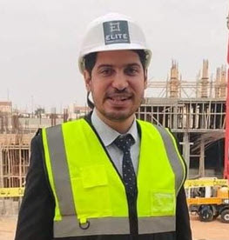
Our Team
Walid Ghobashy Saqr
Sameh Ghobashy Saqr
Ahmed Ashraf Al Kasas
Amr Ahmed Mahmoud Khobez
Mamdouh Magdy Abbass
Mohamed Khaled

Slide 3

Project Overview:
Odoo ERP Implementation for Odoo style
Project Title
Implementation of Odoo ERP for Odoo style Furniture Manufacturing

Slide 4
Project Gools
1. On-time Project Delivery.
2. Budget Adherence.
3. User Adoption Rate.
4. System Performance and Reliability.
5. Continuous Improvement.

Slide 5
Project Objectives
Streamline Business Processes
Enhance Data Management
Improve Customer Relationship Management (CRM).
Facilitate Decision Making.
Increase Scalability.

Slide 6

Problem Statement
Before Odoo ERP Implementation
Odoo style faced significant challenges in managing its operations effectively due to the lack of an integrated system. Key issues included:
1. Disjointed Processes.
2. Manual Data Entry.
3. Inadequate Customer Relationship Management.
4. Inventory Management Issues.
5. Limited Financial Insights.

Slide 7
After Odoo Implementation
After Odoo ERP Implementation Post-implementation of Odoo ERP, Odoo style aims to resolve these issues through an integrated and streamlined approach, characterized by:
Integrated Processes.
Automated Data Management.
3. Enhanced CRM Capabilities.
4. Efficient Inventory Control.
5. Comprehensive Financial Management.

Slide 8
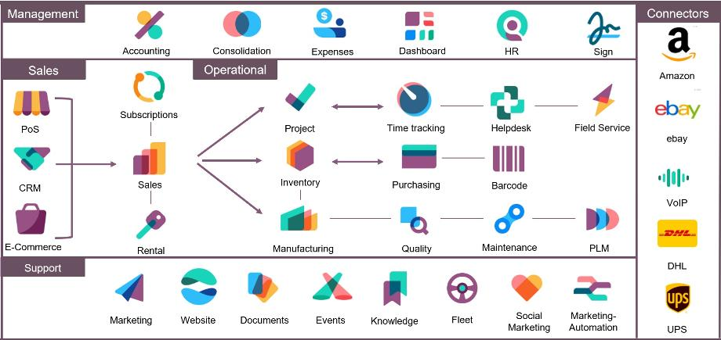
Solution Odoo Apps (Scope of Work)
1- System Installation.
2- User rolls and Security .
3- Website and Ecommerce.
4- CRM.
5- Sales.
6- Inventory.
7- Planning and Production.
8- Purchasing.
9- Accounting and Assets.
10- Human Resources.

Slide 9
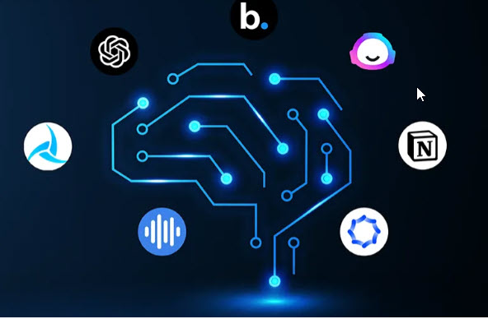
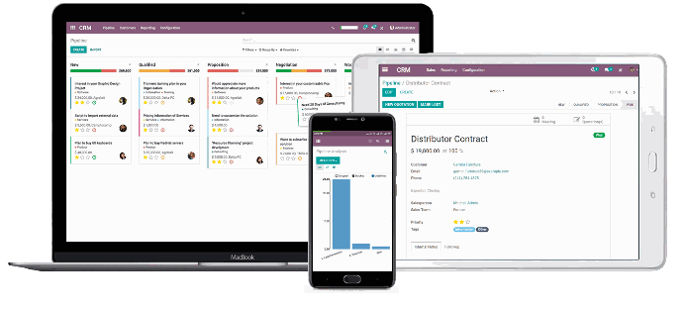
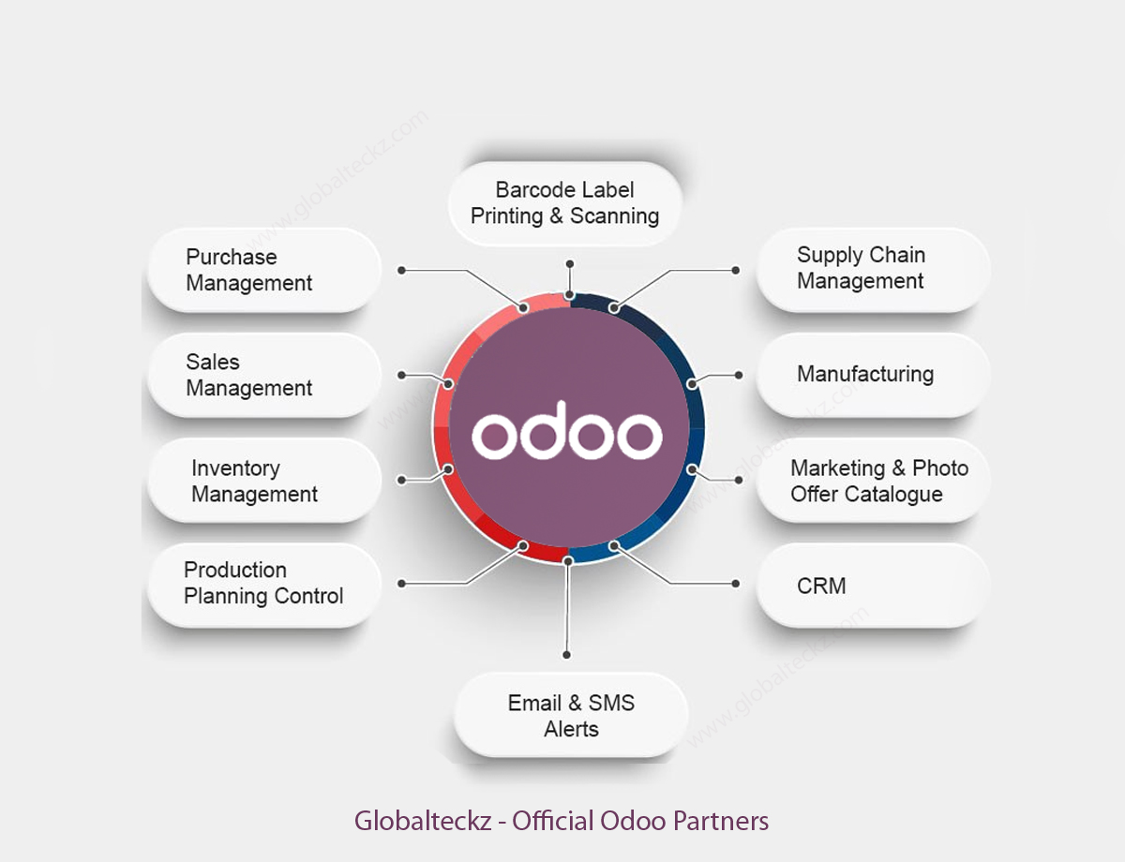
Solution Odoo Apps (Tools and Technologies Used)
1- Odoo Apps
2- ChatGPT
3- Presentation.ai
4- Copilot

Slide 10
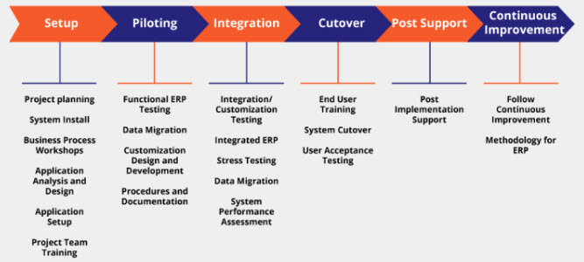
Implementation Methodology ( steps)
1- setup and configuration.
2- Data Migration and uploading.
3- Testing Workflows.
4- Users Creation and Security.
5- UAT and Training.
6- Go Live.
7- Post Implementation.

Slide 11
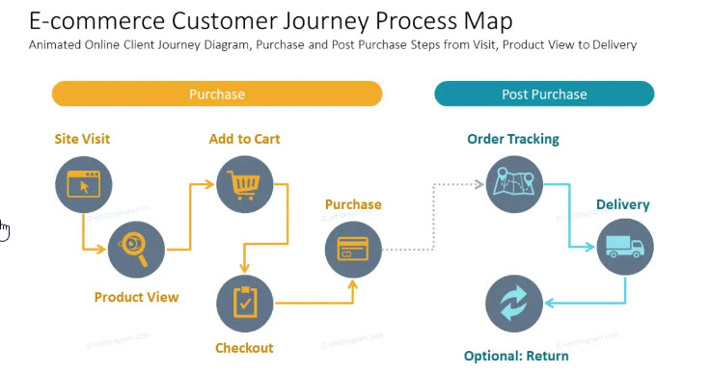
Website Customer Journey

Slide 12
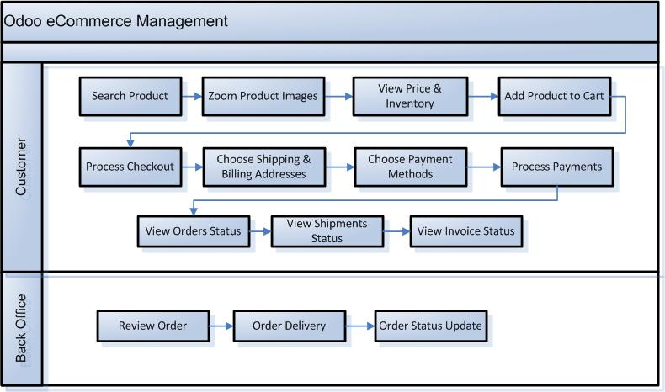
Website Customer Journey

Slide 13
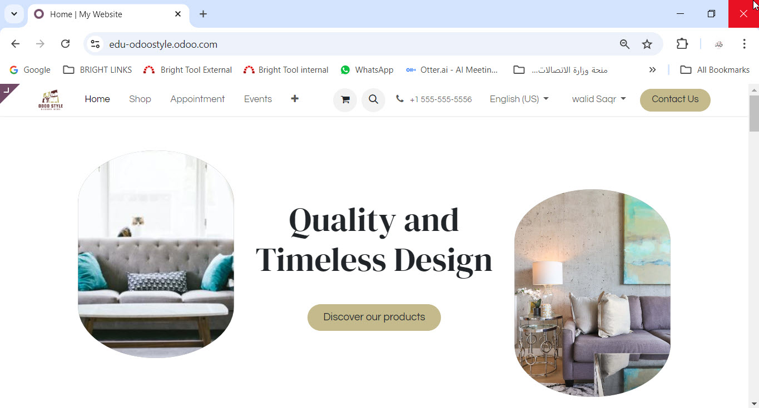
Website Customer Journey
https://edu-odoostyle.odoo.com/

Slide 14
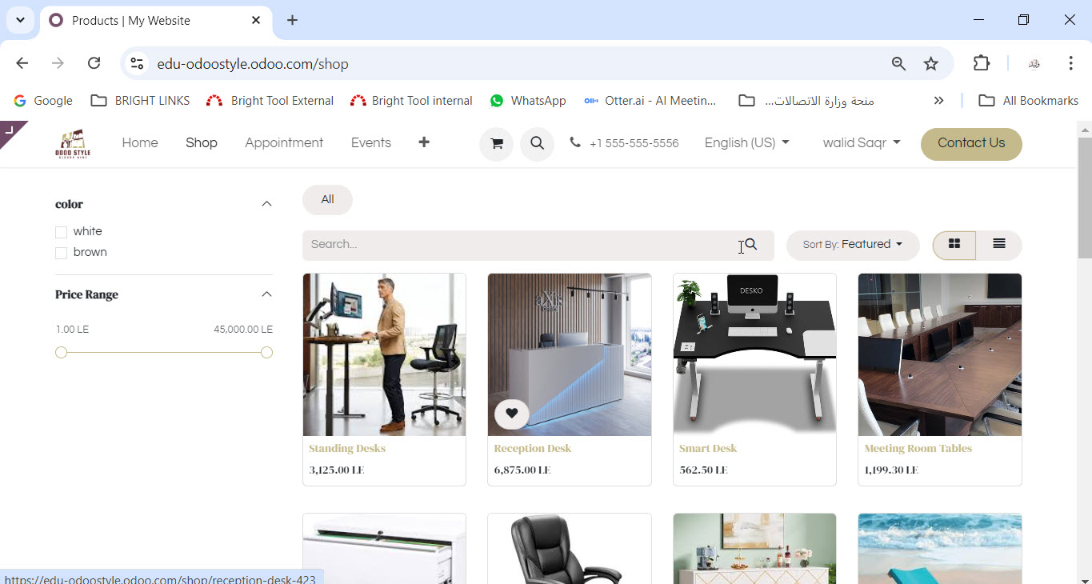
Website Customer Journey
https://edu-odoostyle.odoo.com/

Slide 15
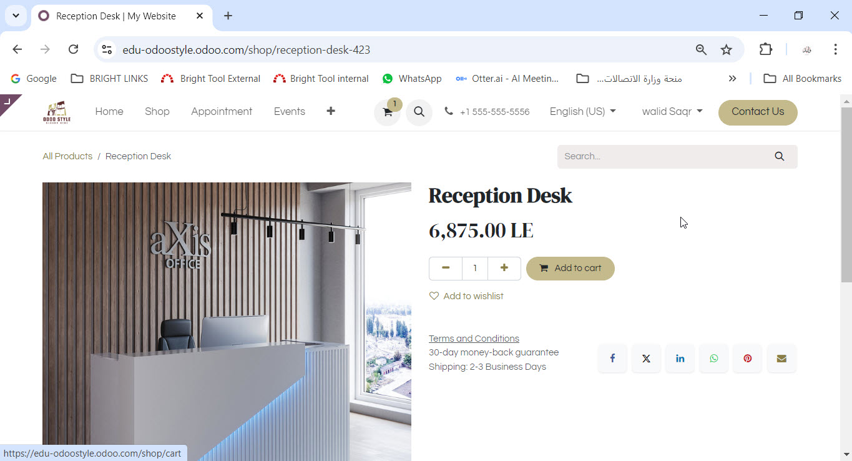
Website Customer Journey
https://edu-odoostyle.odoo.com/

Slide 16
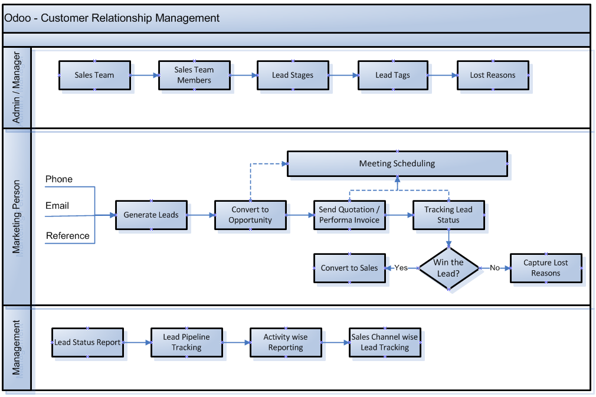
CRM Process

Slide 17
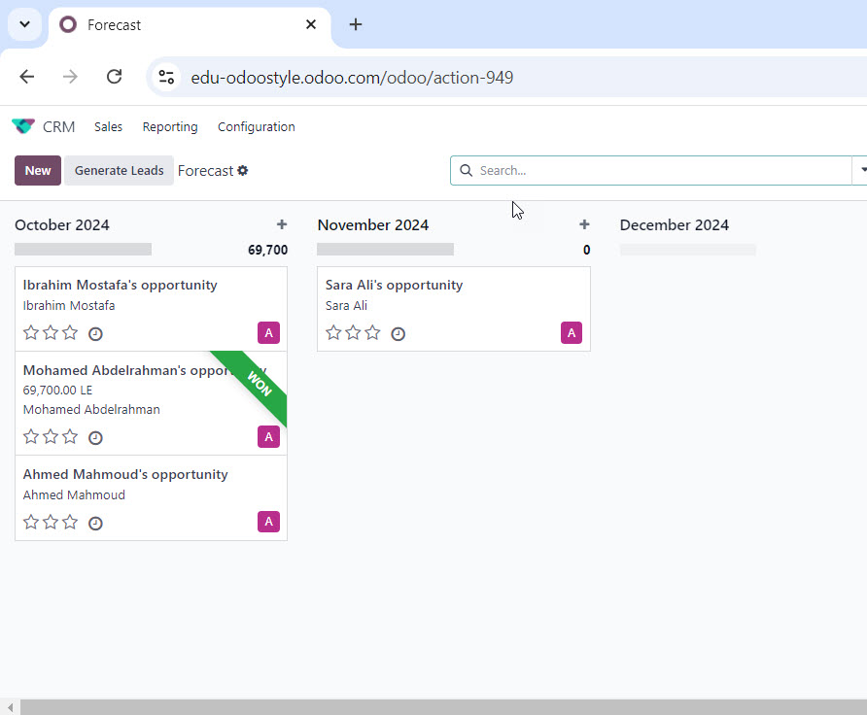
CRM Process

Slide 18
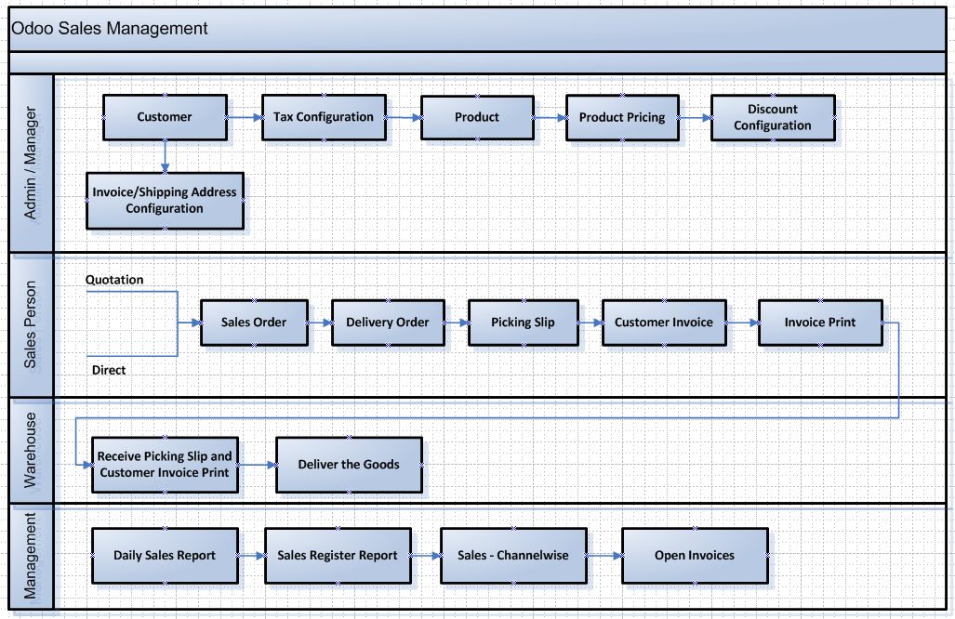
Sales Process Flow

Slide 19
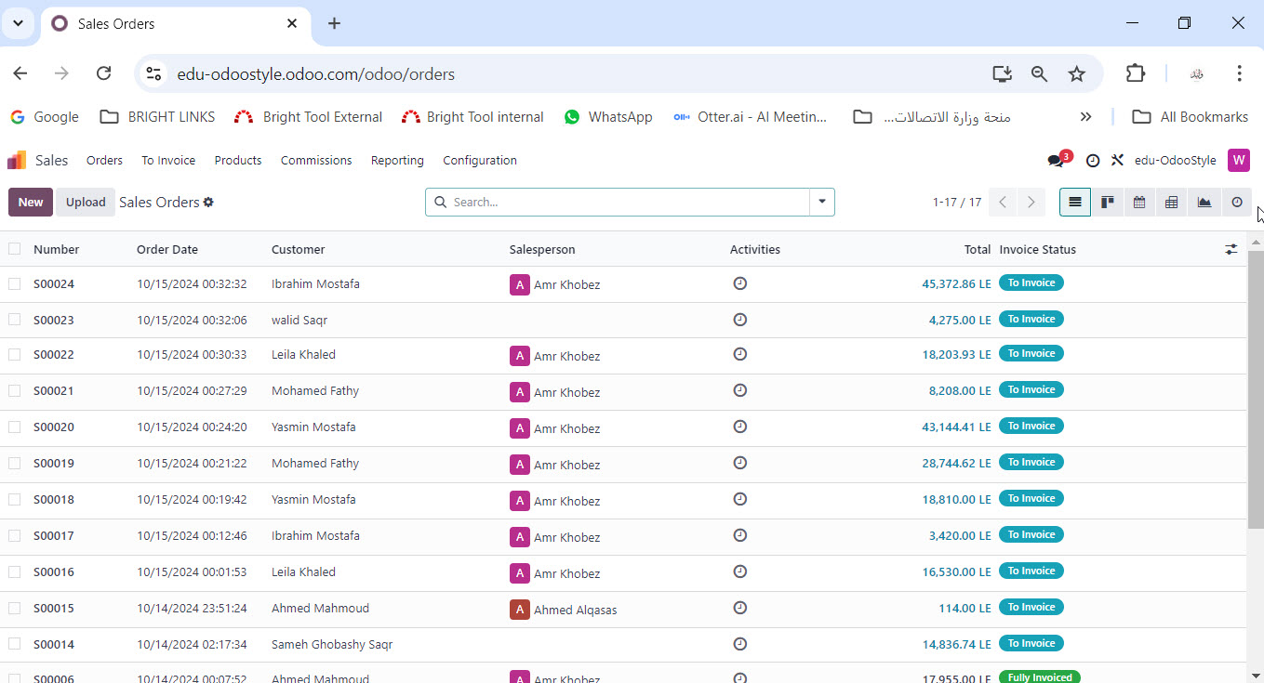
Sales Process Flow

Slide 20
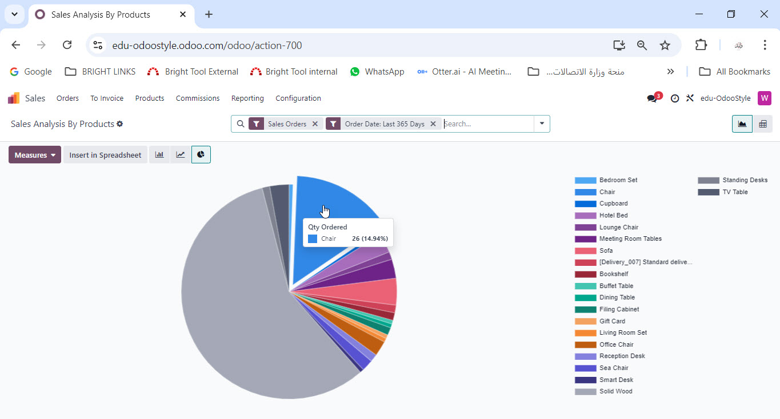
Sales Process Flow

Slide 21
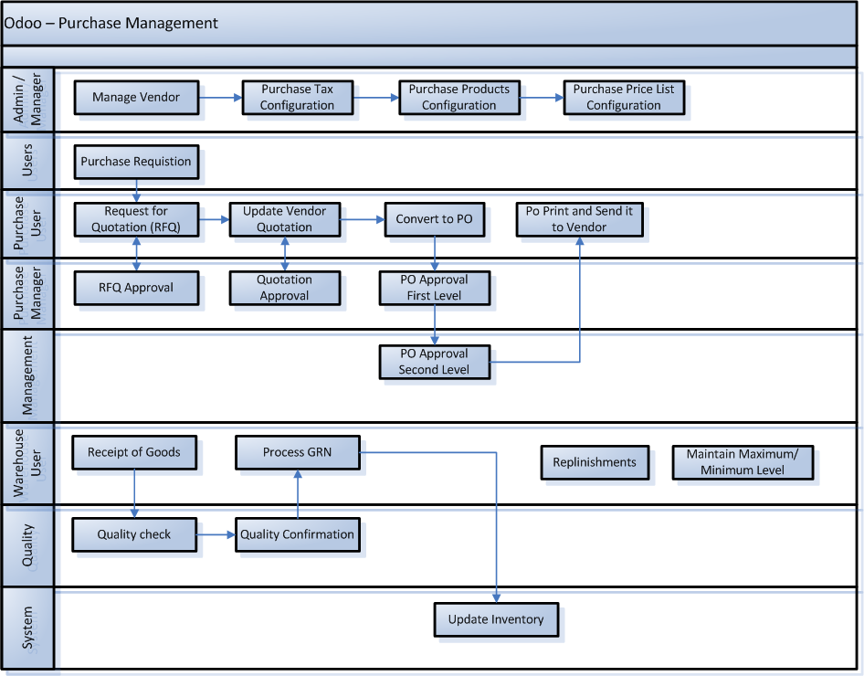
Purchasing Process

Slide 22
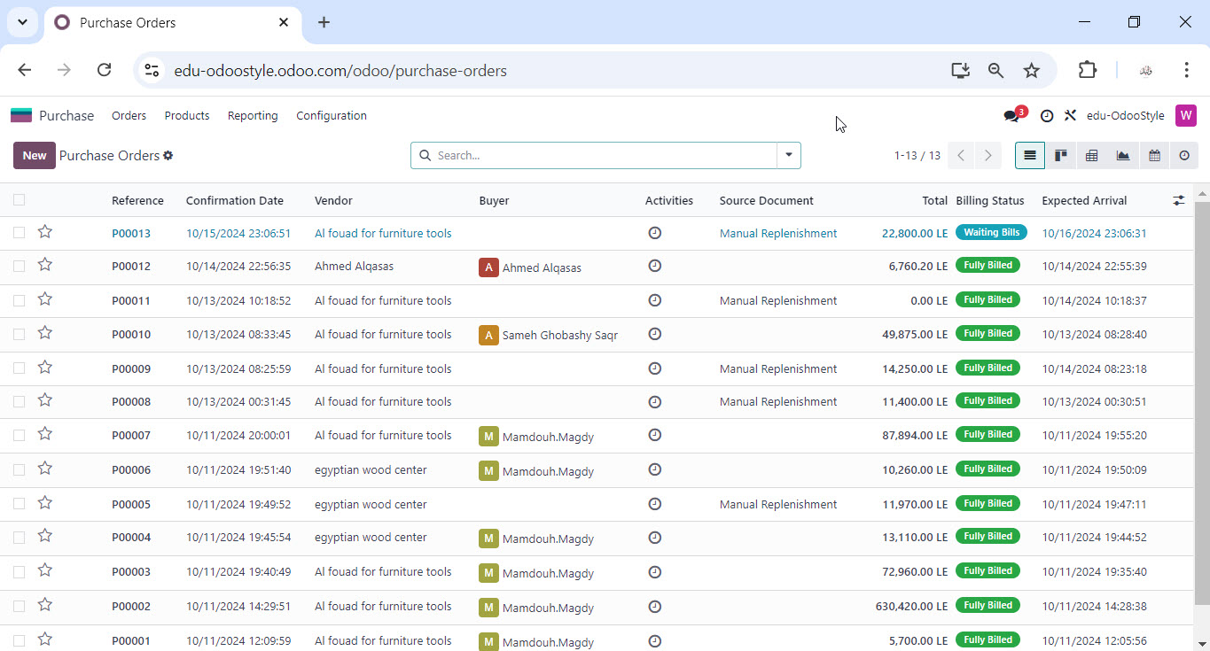
Purchasing Process

Slide 23
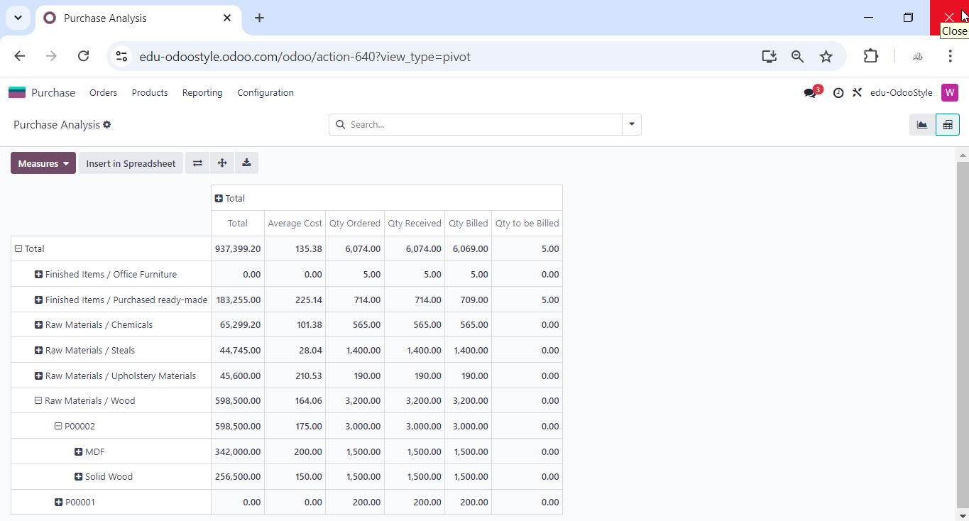
Purchasing Process

Slide 24
Inventory Process
Inventory Settings
Storages Locations
Multi Step Routes
Variants
Units of measure.
Landed Costs
In Accounting Module we will Setup the Stock Valuation
We will use FIFO method for Stock Valuation.

Slide 25
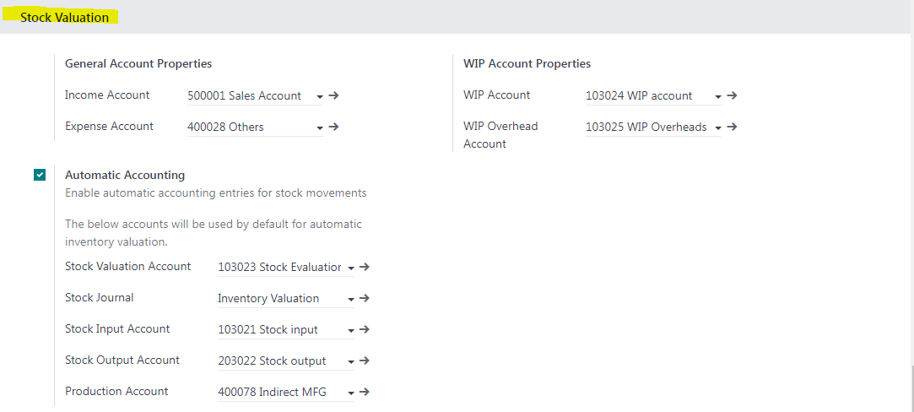
Inventory Process

Slide 26
Inventory Process
Define Product Categories
Parent Categories
Raw Materials
Finished Goods
Raw Materials
Wood
Chemicals
Steals
Upholstery Materials
Finished Goods
Home Furniture
Hotel Furniture
Office Furniture
Purchased ready- made.

Slide 27
Inventory Process
Set Up Products
Prepare Products Master date to upload it on the Odoo system.

Slide 28
Inventory Process
Setup Warehouses
4 Warehouses
Factory/ Raw Materials
Factory/ WIP Warehouse
Factory/ Finished Goods
furniture showroom / Finished Goods
Finished Ready Made Goods

Slide 29
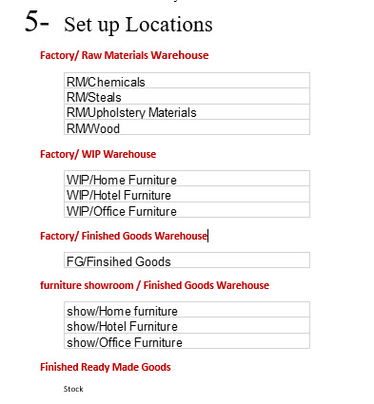
Inventory Process

Slide 30
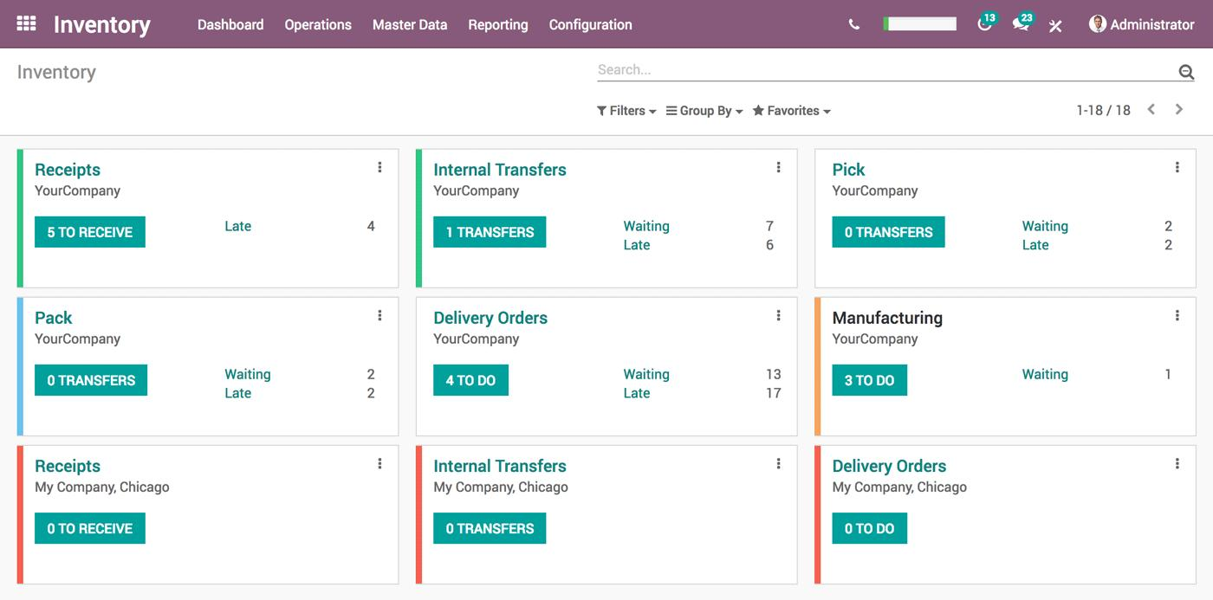
Inventory Process

Slide 31
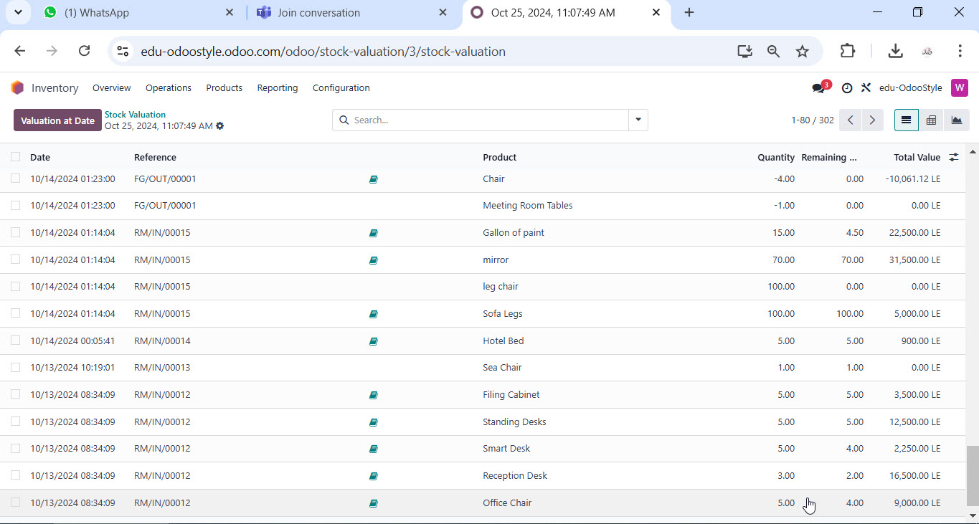
Inventory Process

Slide 32
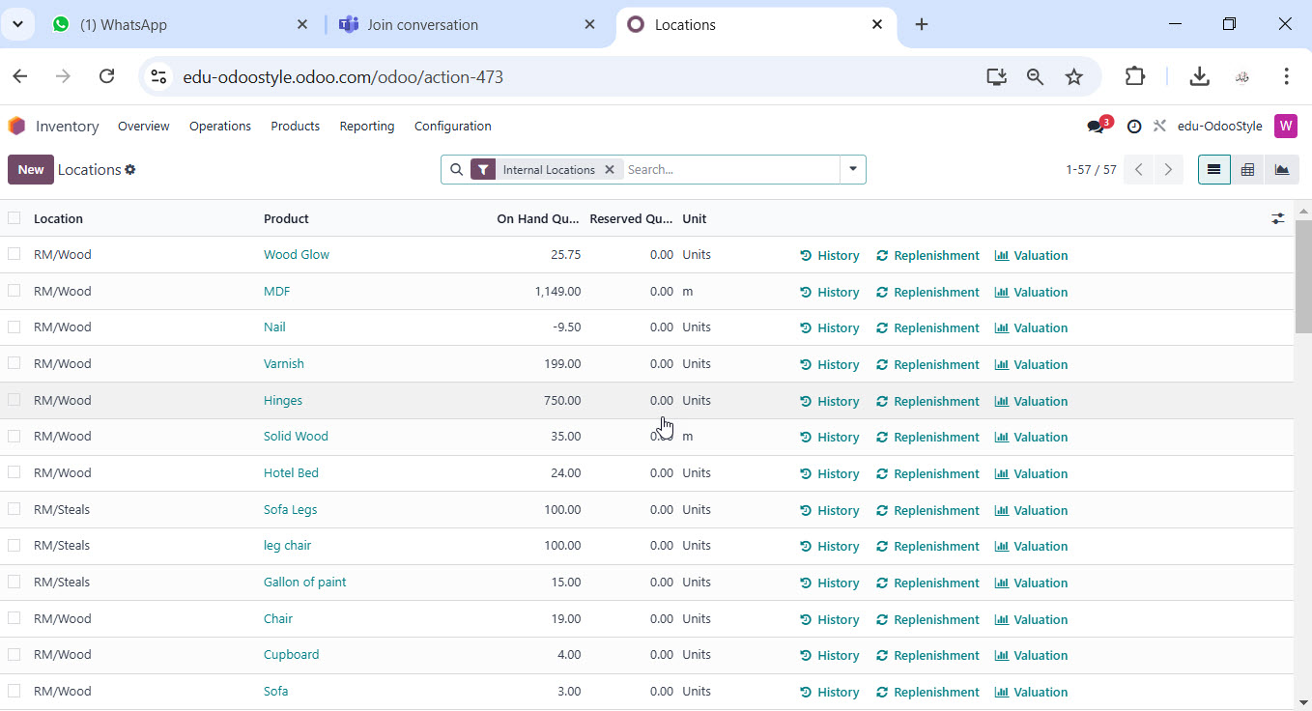
Inventory Process

Slide 33
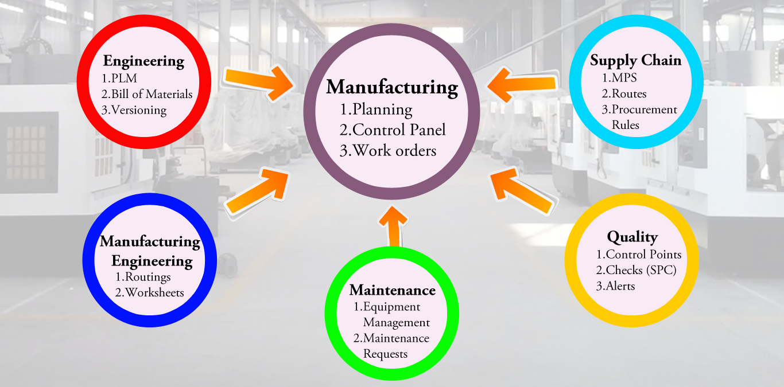
Planning and Production Configuration

Slide 34
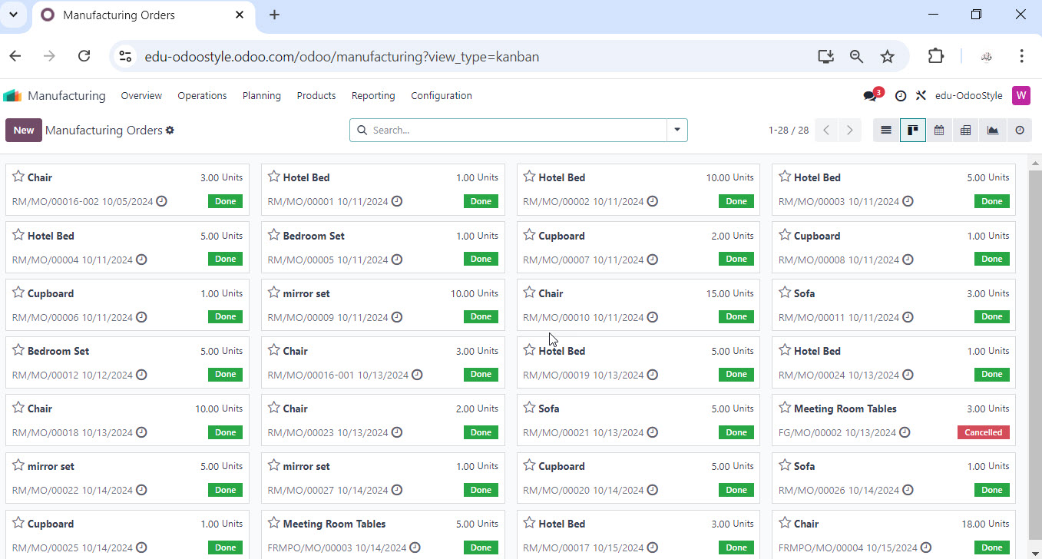
Planning and Production Process

Slide 35
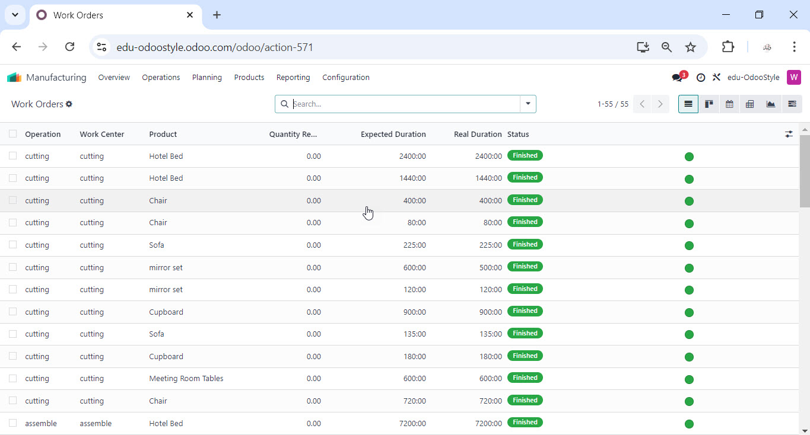
Planning and Production Process

Slide 36
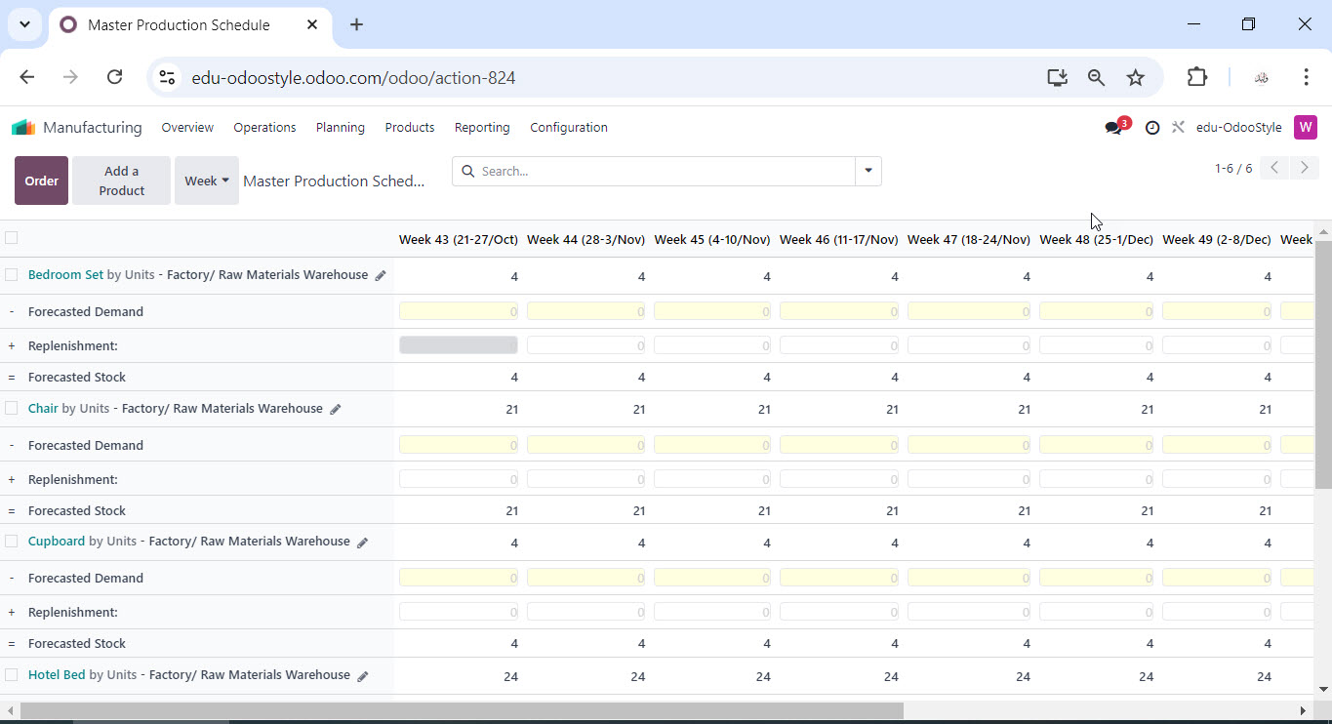
Planning and Production Process

Slide 37
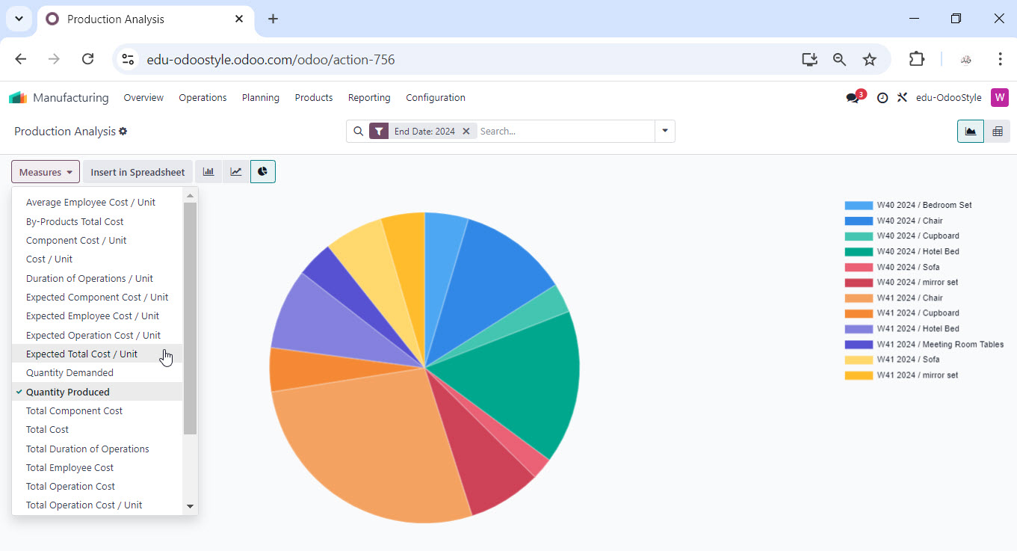
Planning and Production Process

Slide 38
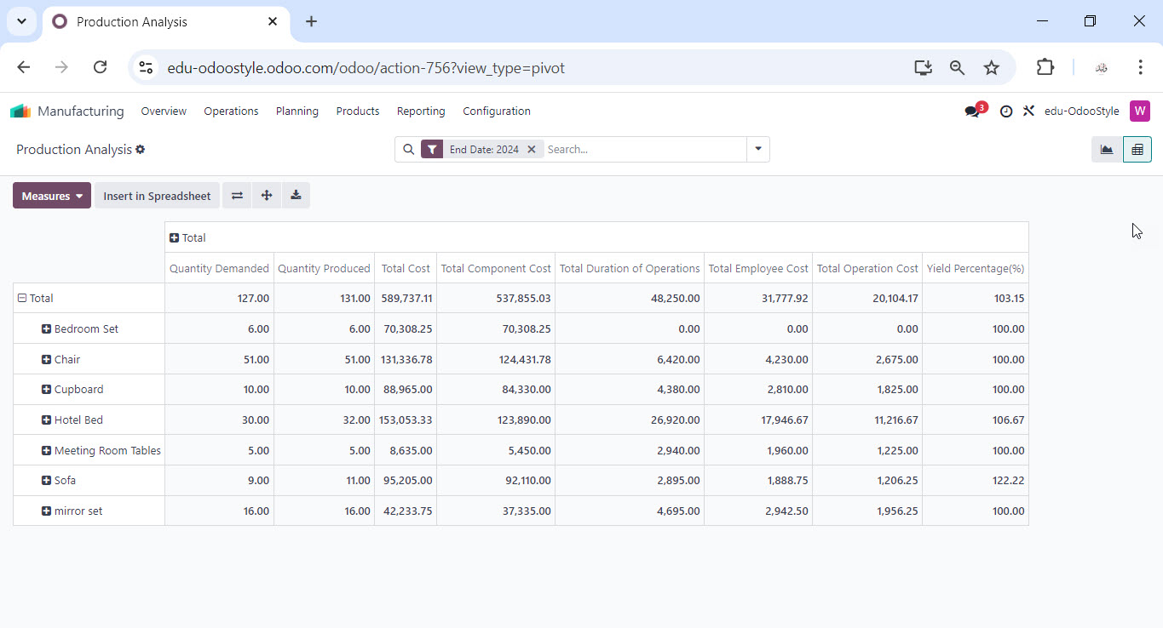
Planning and Production Process

Slide 39
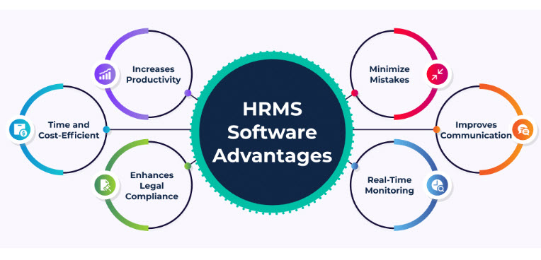
HR Process

Slide 40
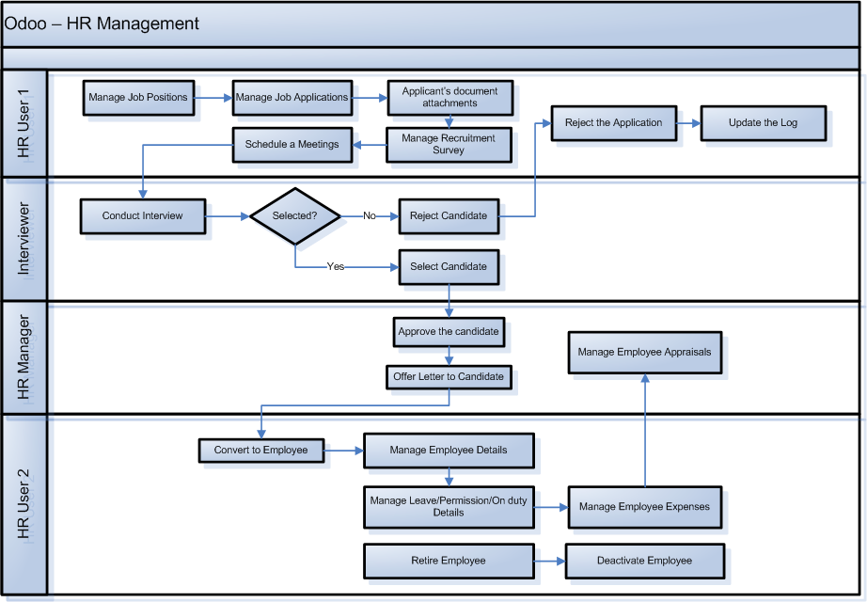
HR Process

Slide 41
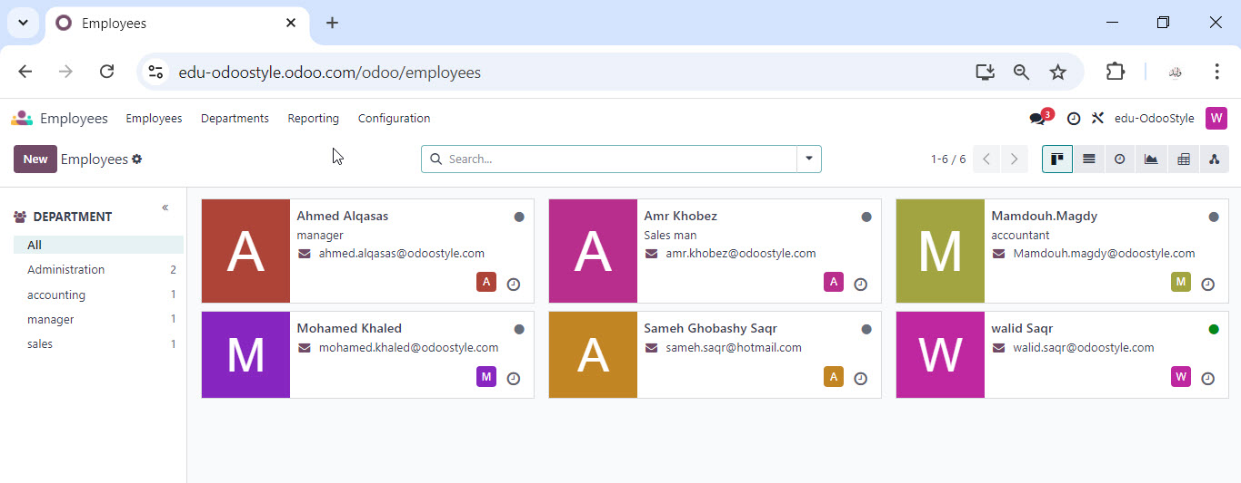
HR Process

Slide 42
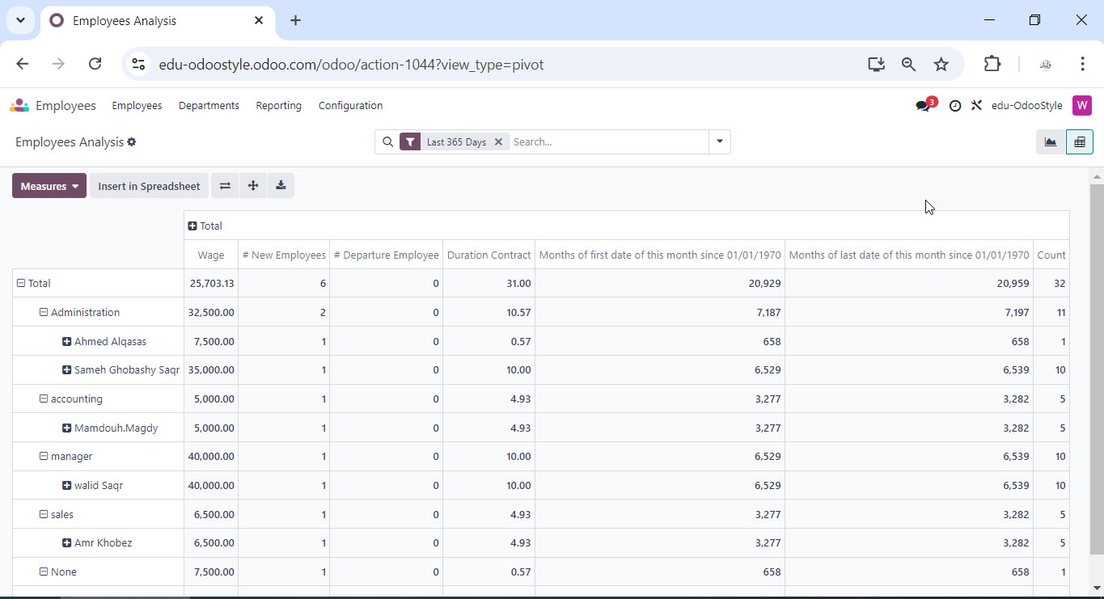
HR Process

Slide 43
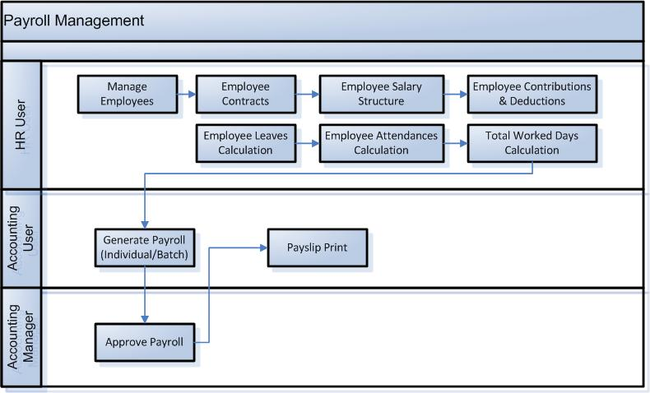
Payroll Process

Slide 44
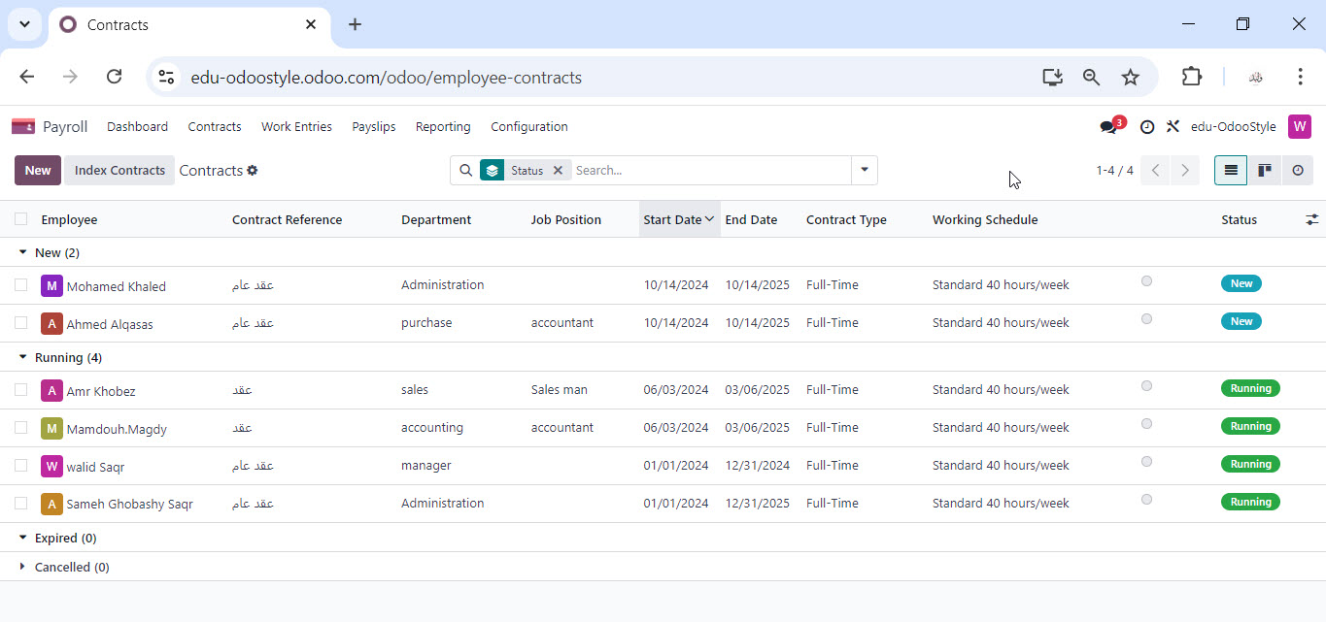
Payroll Process

Slide 45
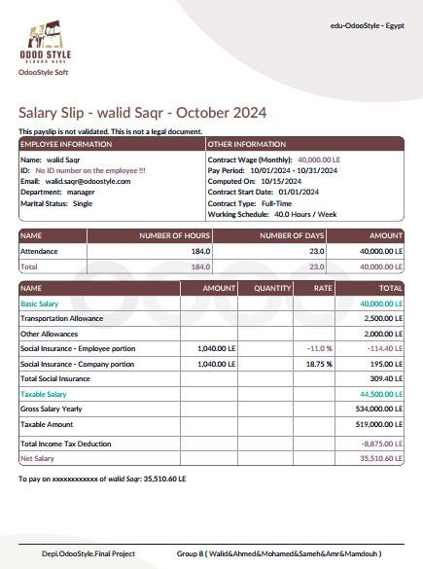
Payroll Process

Slide 46
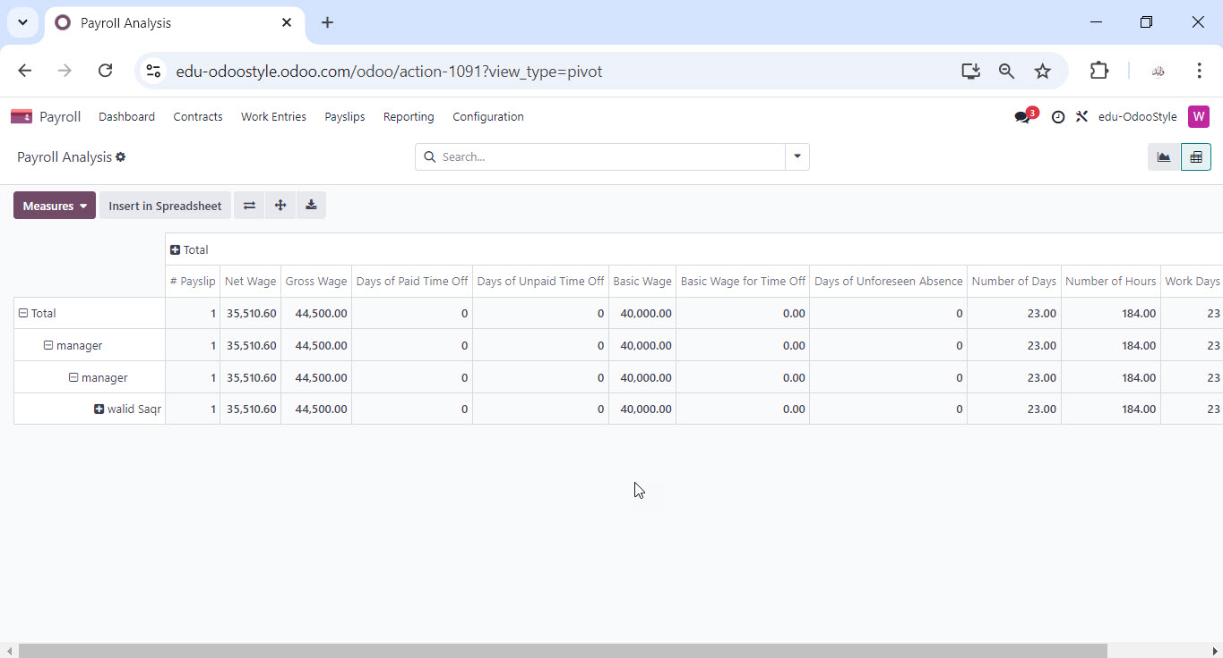
Payroll Process

Slide 47
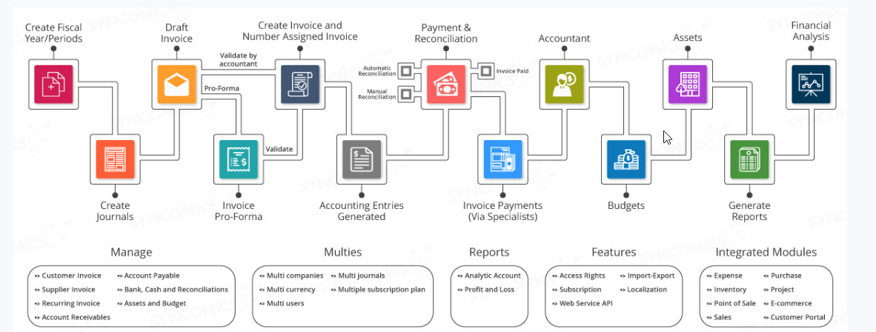
Accounting Cycle and Activities

Slide 48
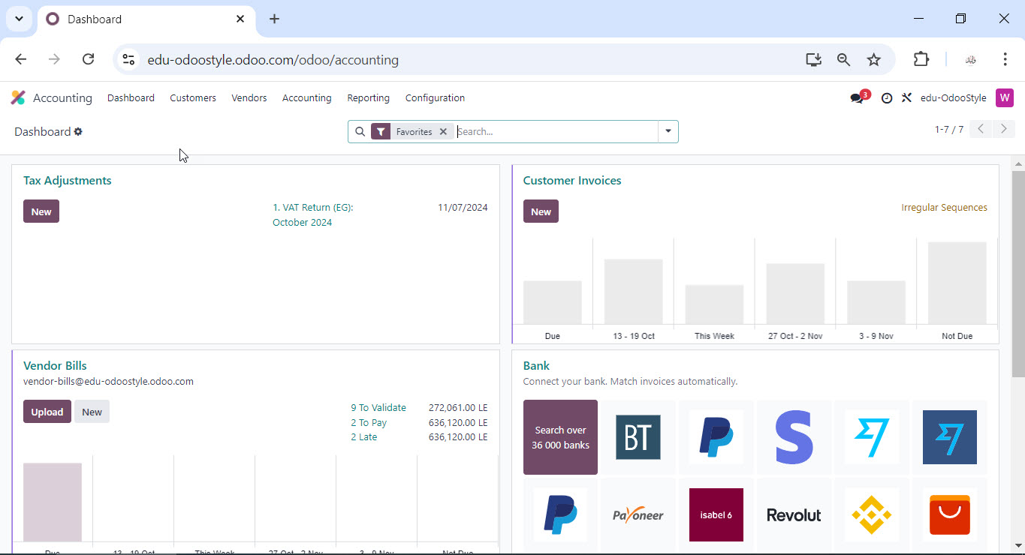
Accounting Cycle and Activities

Slide 49
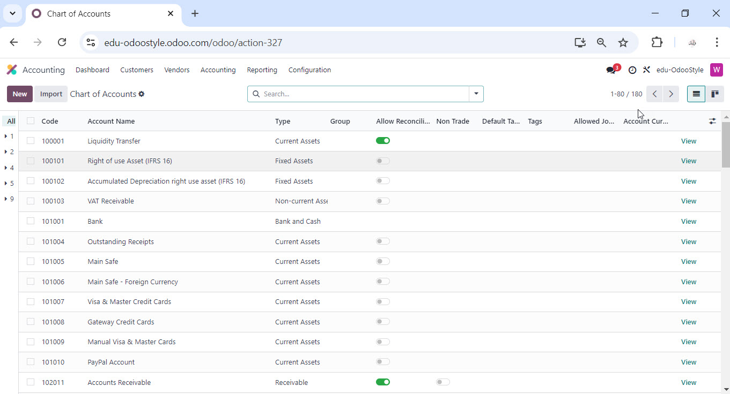
Accounting Cycle and Activities

Slide 50
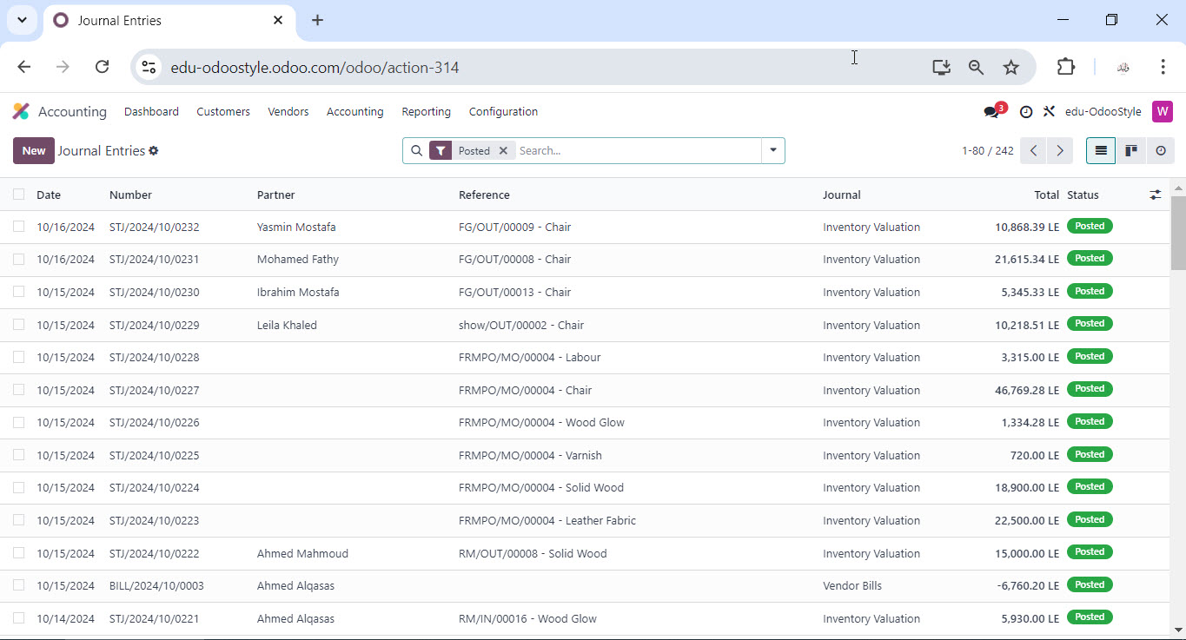
Accounting Cycle and Activities

Slide 51
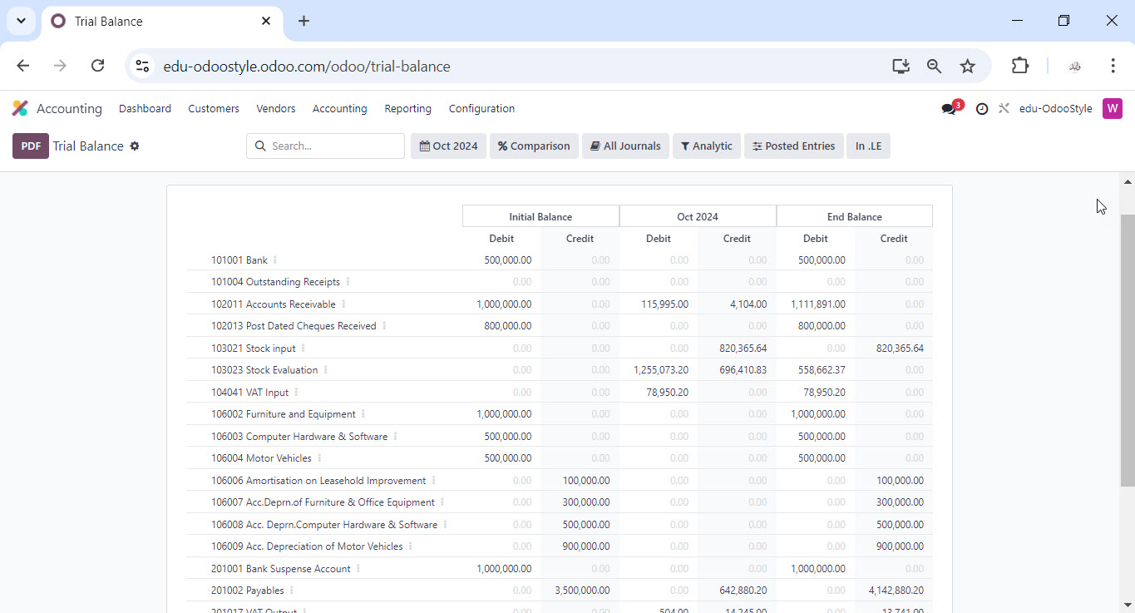
Accounting Cycle and Activities

Slide 52
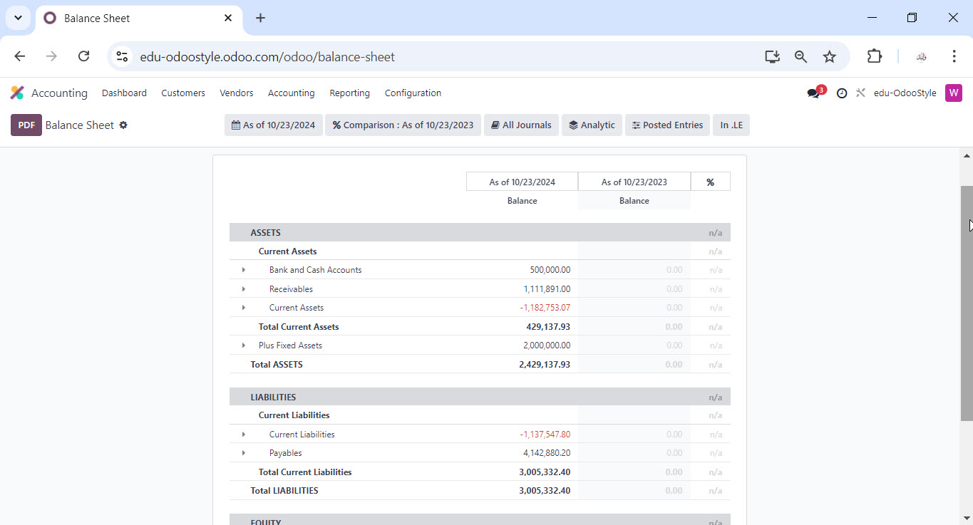
Accounting Cycle and Activities

Slide 53
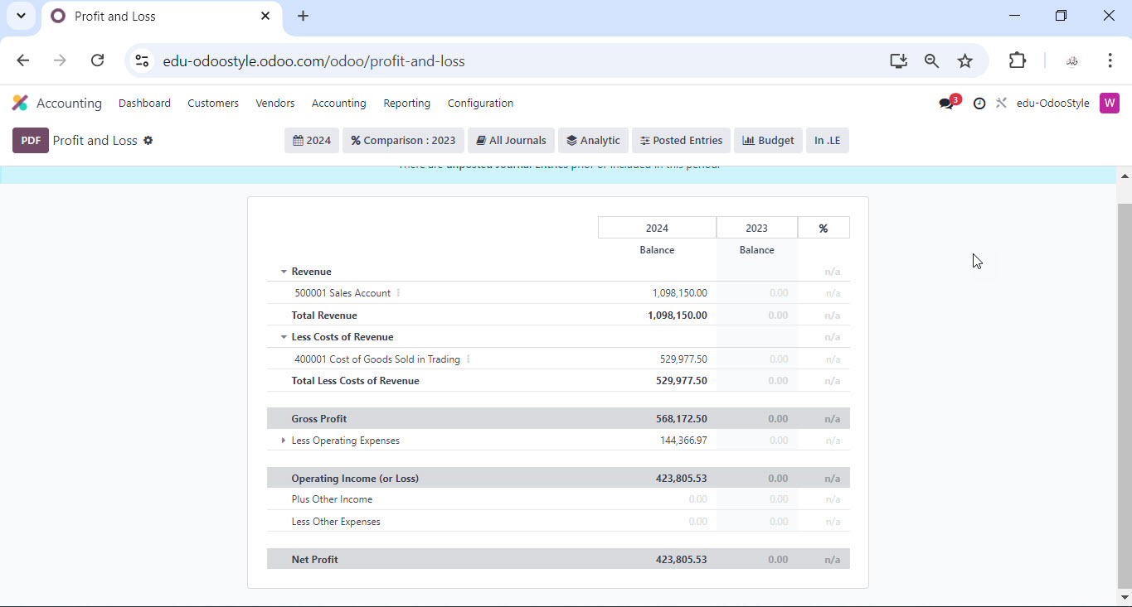
Accounting Cycle and Activities

Slide 54
Project Outcomes
1. Improved Efficiency.
- Streamlined Processes.
- Integrated Workflows.
2. Enhanced Data Visibility
- Real-Time Reporting.
- Centralized Database.
3. Cost Reduction
- Lower Operational Costs.
- Reduced IT Expenses.
4. Scalability.
- Adaptable System.
- Support for Multi-Company
5. Improved Customer Satisfaction
- Faster Response Times.
- Better Customer Insights.
6. User Adoption and Training
- User-Friendly Interface.
- Training Programs.
7. Enhanced Compliance and Security
- Regulatory Compliance.
- Data Security.
8. Project Management and Collaboration
- Integrated Project Management Tools.
- Team Collaboration Features.
9. Customization and Flexibility
- Modular Approach.
- Custom Development.

Slide 55

Thank You
Special Thanks To :-
Dr. Hoda Baraka
Dr. Hisham Farouk
Dr. Ahmed El-Warith
Eng. Mostafa Mancy
https://edu-odoostyle.odoo.com/
October 2024

Slide 56
Thank You
https://edu-odoostyle.odoo.com/
October 2024

